Slide 1
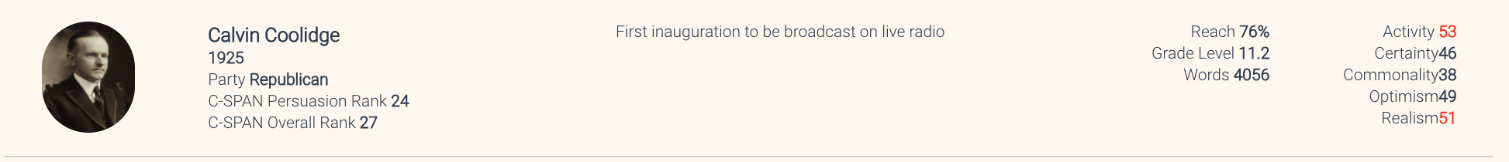
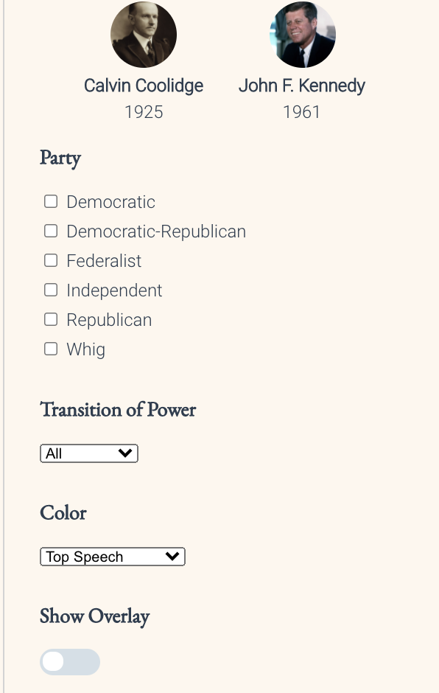
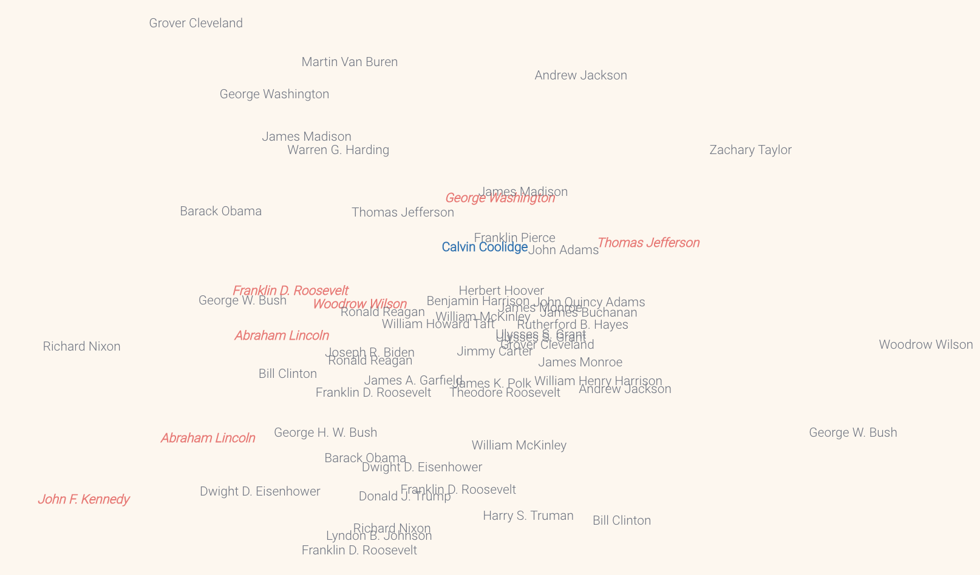
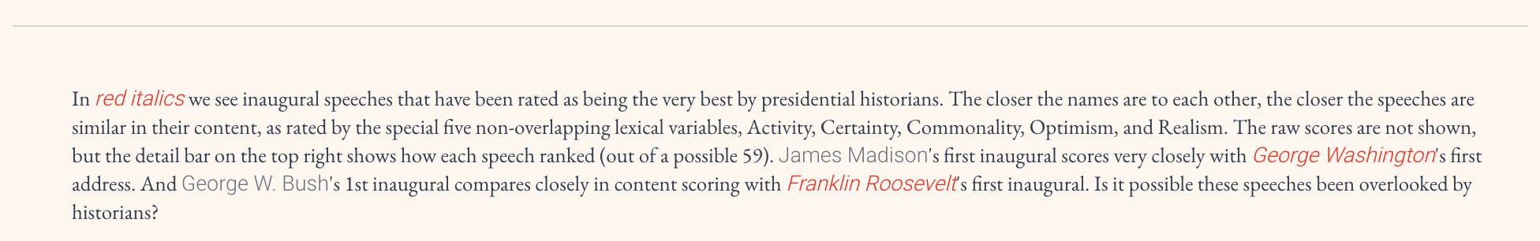
Navigate
Details
The Field
Mouse over these items to get details, or click to save.
Interact
Click to Filter, Change Colors, Turn on Overlays
Explain

